Slide 1
ORLJ 4009 Session 5.0 Experimental, Quasi-experimental and Pre-experimental Designs
Madhabi Chatterji, Ph.D.
Professor of Measurement, Evaluation and Education
Teachers College, Columbia University

Slide 3
Hypotheses vs Theoretical/Conceptual Frameworks
Theory: There are many definitions of the term “theory”
When empirical studies test a theory, it is usually represented as a set of interrelated hypotheses derived from previously accumulated knowledge/research. Conceptual Frameworks (also called Logic Models) are tools to graphically depict these relationships
Hypotheses could project cause-effect or associative relationships among selected variables, suggesting pathways by which the phenomenon is expected to work.
Hypothesis: FALSIFIABLE statement of causal effect OR association between two or more variables selected for examination via a quantitative study design.
Research Hypothesis
Increased Canvas exposure will raise student test scores in TCs programs/courses.
Null or statistical hypothesis
There will be no difference in average student test scores in TCs programs/courses with varying levels of Canvas exposure
H0 : μ (T) - μ (C) = 0

Slide 4
Experimental and Quasi-experimental designs
Hallmarks of a good experiment
1. Control (of all factors other than the one being investigated)
2. Manipulation (of the independent variable—the “experimental” treatment)
3. Comparison (with other cases from the same population, who are withheld from the treatment)
Usually—Group Mean Comparisons (An Experimental Treatment vs. Control Group or Groups)
Goal: Causation-Generalization
Outside factors: Extraneous Variables; Confounding Variables
Typical Research Question:
Did variability in the experimental treatment (X, independent variable--no treatment=0 vs some treatment=1, vs. full treatment=2) cause a change in the desired outcome (Y, dependent variable, a measurable construct), all else controlled or held constant, in a selected sample from the population?

Slide 5
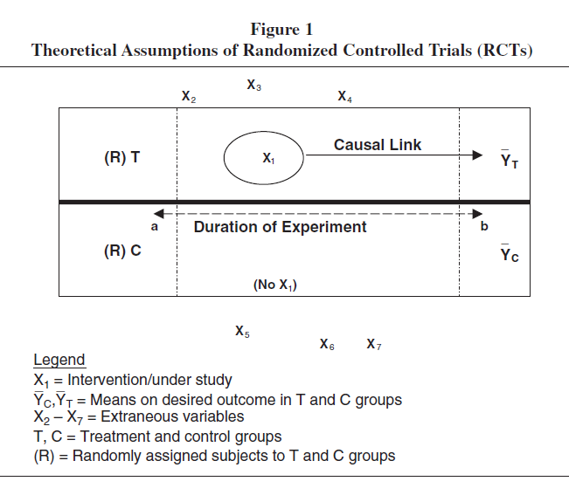

Slide 6
Experimental, Quasi-experimental and Pre-experimental Designs
Four criteria for evaluating research with experimental designs:
Internal validity (Tightness of the experiment: Did X lead to Y, ruling out chance?)
Key strategy: RANDOM ASSIGNMENT OF CASES TO T AND C CONDITIONS
External validity (Generalizability: Can results of the experiment as a mean difference, be extrapolated beyond the sample to the population?)
Construct validity of outcome measures (Was the dependent variable measured in a valid and reliable way?)
Statistical validity (Choice of appropriate analytic methods that fit the goals of the study and allow rejection of the Null Hypothesis)
H0 : μ (T) - μ (C) = 0
Every study has limitations, and researchers should try to balance and optimize the four kinds of validity

Slide 7
Threats to External Validity-
Q. Will the results extrapolate beyond the cases studied, to other samples from the same population, settings, time points?
Effective Sampling Designs
Sample → Population
NOTE: Difference between “random sampling” and “random assignment”
Situation-specific interactions among X and other factors/conditions that bar generalization beyond sample studied (Campbell & Stanley, 1966)
Interaction of Treatment and Selection
Interaction of Testing and Treatment
Multiple interpretations with X
Reactive arrangements

Slide 8
Causality and internal validity
Campbell and Stanley’s (1966/1968) seminal work in experimental and quasi-experimental research designs identified factors that could undermine internal validity of experiments
Selection
History
Instrumentation
Testing
Regression towards the mean in change experiments
Attrition (Subject Mortality)
Maturation

Slide 9
Threats to Internal Validity of Experiments
Selection biases: Sample selection issues. ). Random assignment is the only way to control this threat. Differences in outcome scores exist because of pre-existing group differences. Happens when there is no random assignment or poorly executed random assignment of cases(but there are 2 or more groups – does not happen in single group studies
History: Events that take place during the course of experimental treatment that might influence outcome measurement/scores instead of the treatment. E.g. national event (9/11), fire during study, flu season. A control group can help assess and evaluate effects of history.
Instrumentation: Applies to all change experiments—longitudinal designs with pre-post treatment measurement of change) differences in how the dependent variable was measured before and after, can interfere with results (e.g. different tests, different raters, different scoring system). Can’t know if change due to treatment or change in measurement. Prevent with control group that gets same measures – or by using the same instrument twice.
Testing (Practice effect): Pretest measurement influences the posttest measurement – E.g., due to practice effect, or priming for experiment alters outcomes in participants

Slide 10
Threats to Internal Validity
Regression Toward the Mean: Applies to change experiments. Extreme scores in the pretest tend to regress toward the mean in the posttest. A problem when you choose to focus on a subset of the initial sample with extreme scores and the outcome measure has “ceiling” and “floor” effects and unreliable scores.
Subject Attrition (Mortality): Drop-out rate of participants is different in different groups either in magnitude (more drop-outs in one group than the other) or by type (different type of drop-outs in each group.) Random assignment does not help (though it is worse if no random assignment.)
Maturation: Naturally occurring development or changes in the persons in study groups over time that might have influences on outcomes. Can assess better with use of control group.

Slide 11
Classes of Experimental Designs The Pre-experimental design
Design | Advantages | Threats to Internal Validity
PRE-EXPERIMENTAL DESIGNS
One-Shot Case Study X O | None (but sometimes may be the only way to study impact of something.) | History, Maturation, Selection, Mortality,
One-Group Pretest-Posttest Design O X O | Selection (to some extent) | History, Maturation, Testing, Instrumentation, Interaction of Selection and Maturation, maybe Regression to the Mean, Mortality
Static Group Comparison X O_{a} O_{b} (no randomization) | Claims: Controls Threats to a Change Experiment; History, Testing, Instrumentation, Regression | Selection, Mortality

Slide 12
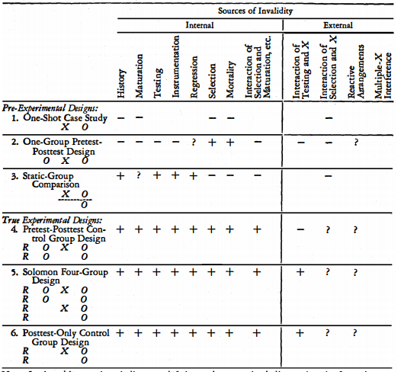
From Campbell &Stanley (1966)

Slide 13
“True’ Experimental designs– Use Randomization Strategies
Design | Advantages | Threats to Internal Validity
Pretest-Postest Control Group Design R O_{1A} X O_{2A} R O_{1B} O_{2B} | Change experiment Controls all threats to internal validity (with the potential of History if something happens to one arm of the study only) | Mortality
Solomon Four-Group Design R O_{1A} X O_{2A} R O_{1B} O_{2B} R X O_{2C} R O_{2D} | Controls all threats to internal validity plus Testing x Treatment external validity threat | Possibly Selection x Treatment and Reactive Arrangements, Mortality
Posttest-Only Control Group Design R X O_{2A} R O_{2B} | Controls all threats to internal validity plus Testing x Treatment | Possibly Selection x Treatment and Reactive Arrangements; without pretest can’t test more subtle effects

Slide 14
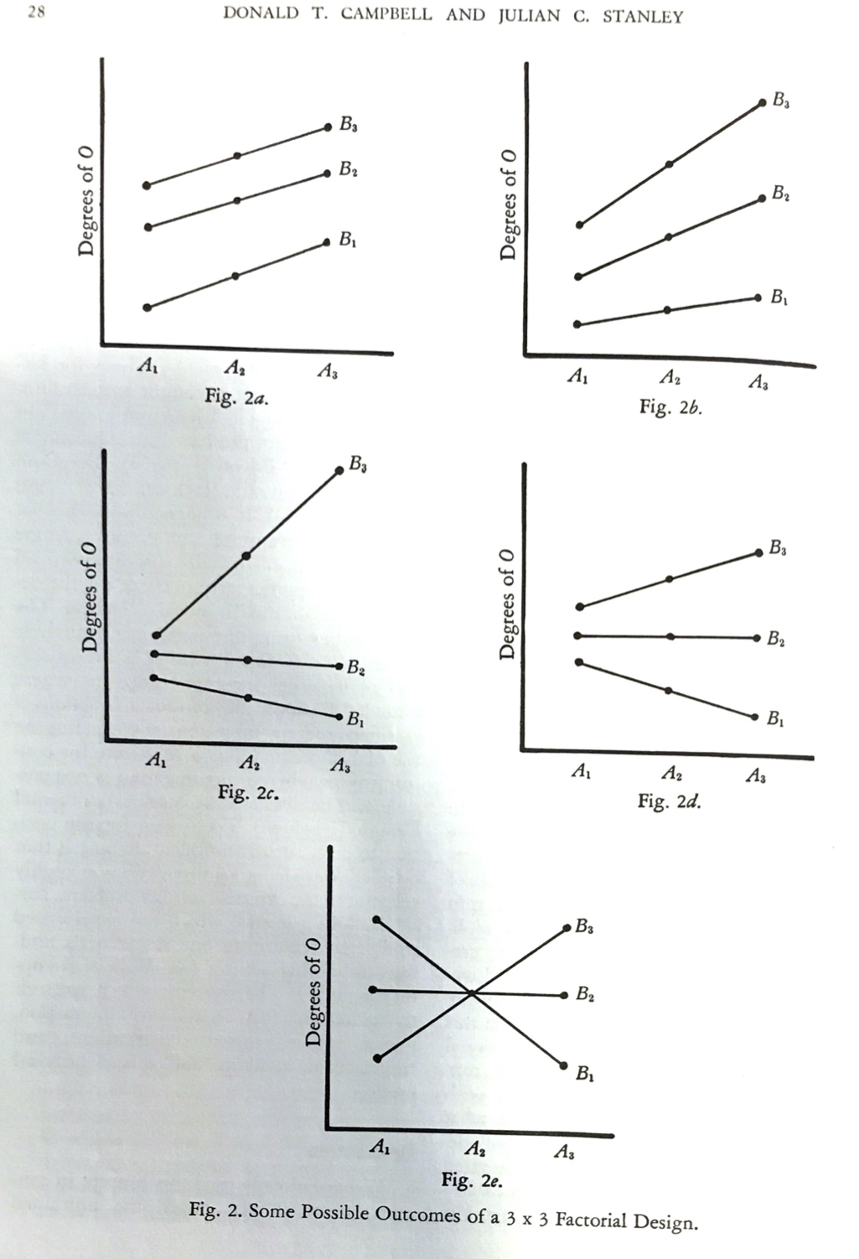
Moderator or “Interaction” Effects in True Experiments with Mean Comparisons among Three Groups, B1 (treatment), B2 and B3
Notes:
B= (Treatment--No Canvas, Some Canvas, Full Canvas exposure)
O is a dependent variable (test scores)
A is the Moderator Variable ( A1, A2, A3, e.g., no prior IT experience, 1 year, 2+ years)
Fig 2a: No interaction
Figs 2b-2d: Some interaction
Fig 2e: Strong and significant interaction

Slide 15
Quasi-experimental designs
Design | Advantages | Threats to Internal Validity
Time Series Design O O O O X O O O O X O | Subjects as their own controls. Controls for Selection, Mortality, Maturation (since know trends over time) | History; requires careful pattern recognition; difficult to detect gradual changes, can’t put too much confidence in causal statements
Nonequivalent but Matched Control Group Design O_{1A} X O_{2A} O_{1B} O_{2B} | No random assignment (using pre-determined groups) – but still controls most threats since people matched by selected background factors and pretests used to control (covariate) | Selection, Maturation (differences in groups could change rate of growth over time) (a pre-test can help, but will still have some selection x maturation problem)

Slide 16
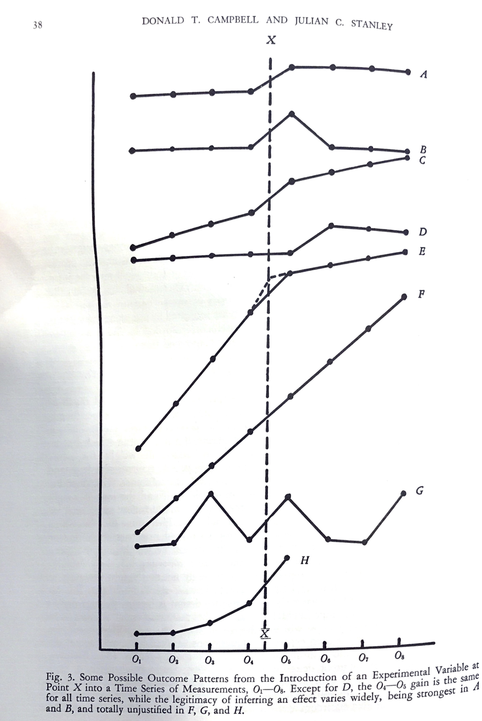

Slide 17
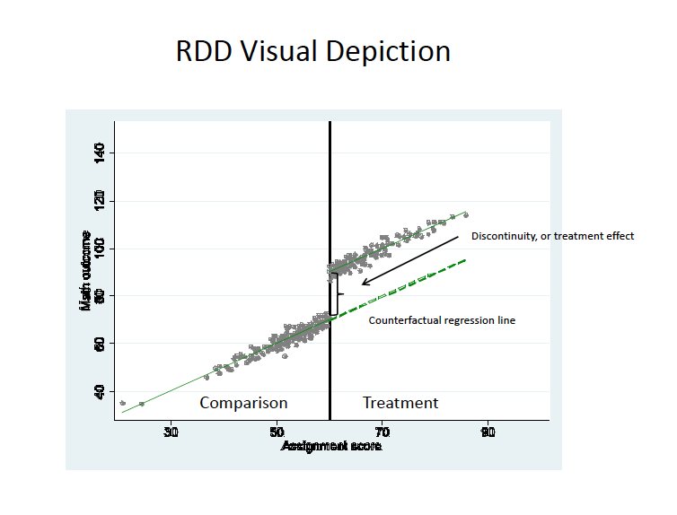
Illustration of another quasi-experimental design for nonequivalent group comparison studies—Regression discontinuity designs (RDD)

Slide 18
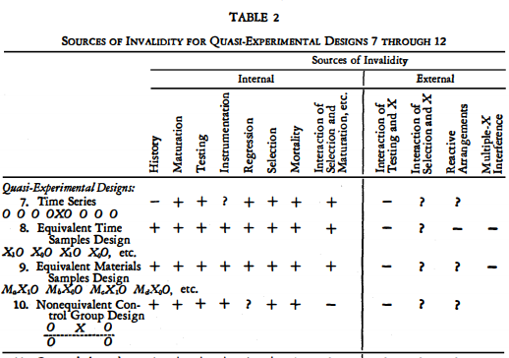
From Campbell &Stanley (1966)

